Slide 1

Welcome
Lab 1- Preparing to Launch an Online Business.

Slide 2
Introduction
Sub-titles Will Look Like This
Expectations
Chat Support Available During Webinars
Knowing Your Resources
Webinar Process
Facebook Support
Search: Crexendo UP Website Competition
Online Resources
up.Crexendo.com/unr

Slide 3
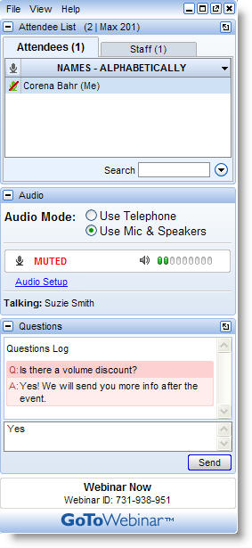
Introduction
Live presentation
Attendees are muted
Type your questions in the “Questions” window
Questions answered live or via chat reply

Slide 4


Introduction
Prepare
Brainstorm
Select
Refine
Research
Browser compatibility – Google Chrome
Use of add-on’s
Business License

Slide 5
Introduction
Prepare
Brainstorm
Select
Refine
Research
Create a list of possible products
Select 1 of your Product Ideas
Take 5 min to think of keyword alternatives for that product
Type in 1 of your keyword ideas in the Google Keyword Tool
Export file
Business License

Slide 6
Introduction
Prepare
Brainstorm
Select
Refine
Research
From your exported file, remove any keyword phrases that are not relevant and/or have a low GMS
Add all of the page ranks within the first page of Google and use the Page Rank Calculator to get the average
  Do NOT include Google Images, Google Shopping, or Google Places results when adding page ranks
Repeat the previous steps with a new keyword idea until you have enough data to review
Copy & Paste the final list of keyword phrases into the Keyword Research Document
Business License

Slide 7
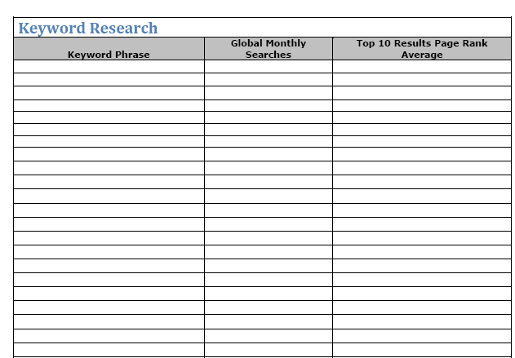
Introduction
Using Google Chrome search for product
Search 1 Keyword phrase at a time
Repeat process until you have the average page rank for all Keyword phrases
Prepare
Brainstorm
Select
Refine
Research
Business License

Slide 8
Introduction
Prepare
Brainstorm
Select
Refine
Research
Using the competition legend, color code your results
Repeat the same process for additional product ideas on a separate Keyword Research template and compare the product markets
Final Step: Select a Product
Business License

Slide 9
Introduction
Prepare
Brainstorm
Select
Refine
Research
Contact your individual state and obtain regulations and requirements
Follow the link on the resources site for further assistance
Business License

